Slide 1
Chinook music store project
By Ashutosh Kar

Slide 2
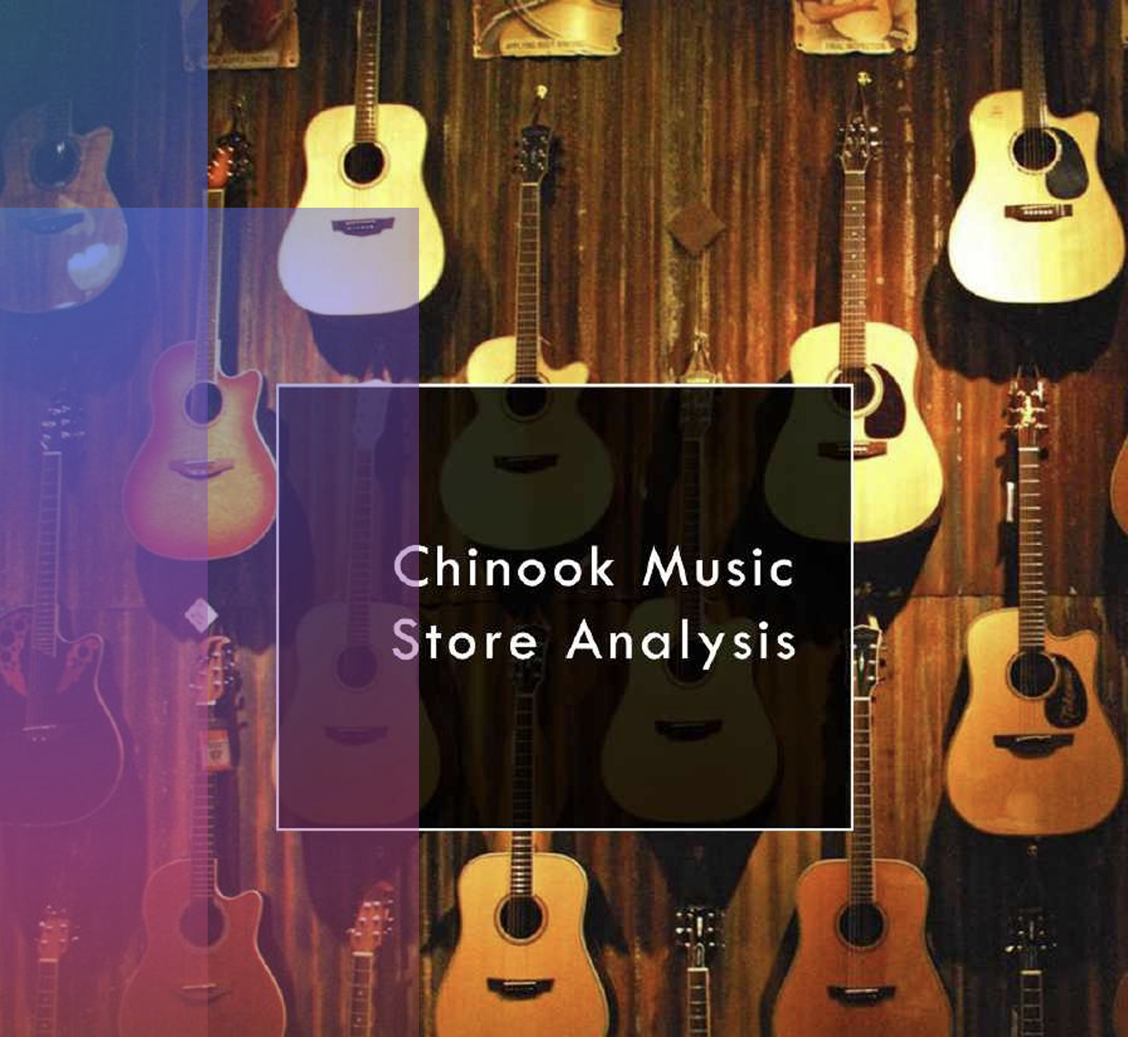
CONTENTs
About Chinook
Chinook Music Store Analysis
Problem Statement
Data Schema Diagram
Data Description
Most popular genres in America based on sales
Most popular genres outside America based on sales
Affinity Analysis
Churn Rate by Region
Region wise purchase behavior
Customer segment based on purchase history
Recommendations
Conclusions

Slide 3

ABOUT Chinook
Chinook Music Store is a digital music retailer selling individual tracks and albums.
It operates in a similar model to iTunes, offering a variety of music genres.
The store sells music in digital format, with customer purchases recorded in a database.
The database includes customers, invoices, tracks, artists, and employees.
Transactions are processed via invoices, linking purchases to customers and payment details.
The store aims to analyze customer behavior, sales trends, and revenue insights for business growth.

Slide 4
Chinook music store analysis
Welcome to our comprehensive analysis of Chinook Music Services. In this presentation, we delve into detailed sales data, emerging market trends, and customer purchasing behaviors to extract meaningful business insights.
Our goal is to provide a data-driven understanding of Chinook’s performance across global markets, highlighting opportunities for growth, customer retention, and improved distribution strategies within the international music industry.

Slide 5
PROBLEM STATEMENT
You are hired as a data analyst at Chinook, and your objective is to analyze music record sales data to gain insights and make recommendations for the company's strategy in the physical music market.
Objectives:
Analyze Music Sales Data – Identify sales trends across different genres, artists, and albums.
Understand Customer Preferences – Study purchase frequency, spending habits.
Identify High-Value Customers – Find top spenders and their buying patterns.
Track Seasonal Sales Trends – Analyze monthly and yearly fluctuations in music sales.
Optimize Inventory & Pricing – Recommend stock adjustments and pricing strategies for maximum revenue.

Slide 6
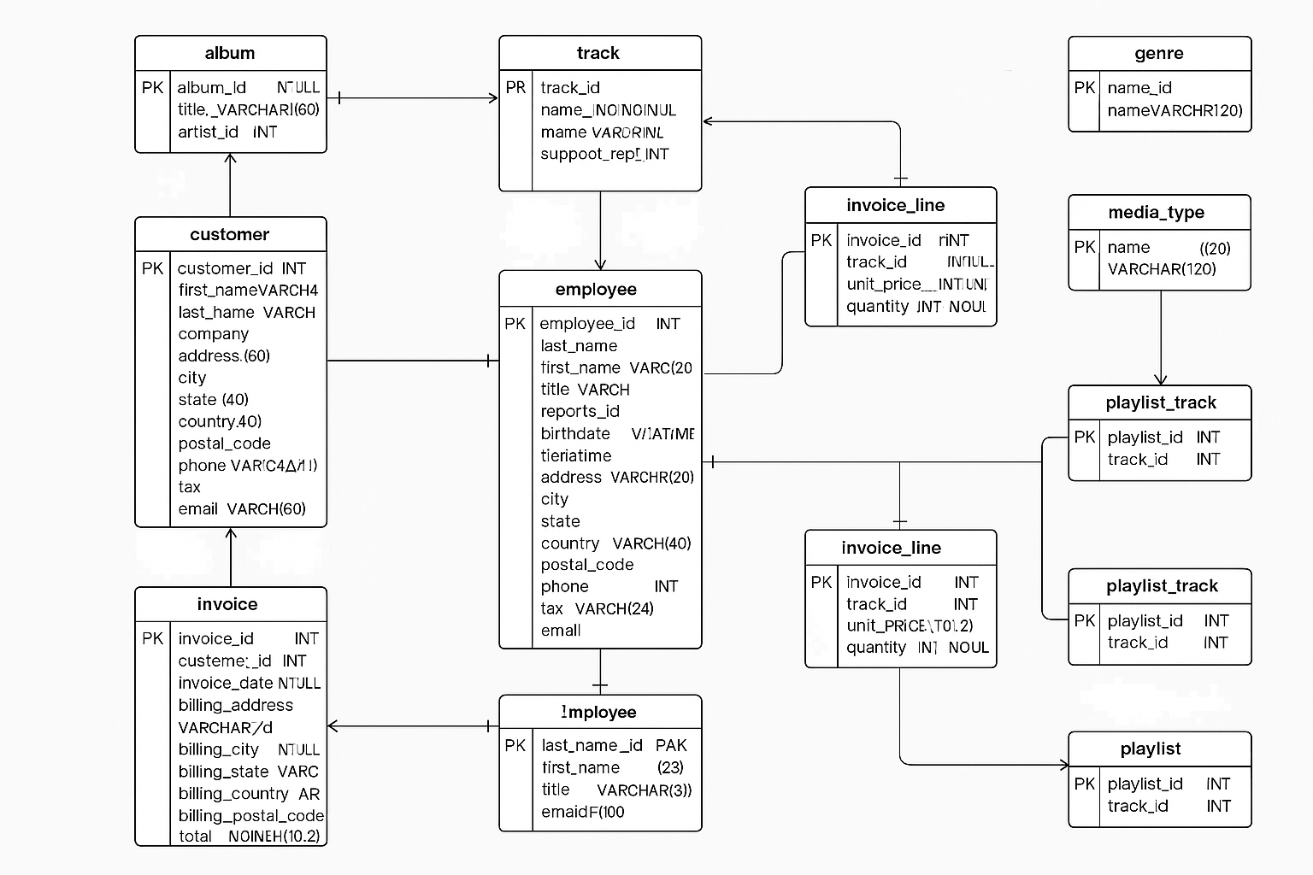
Data schema diagram

Slide 7
Data description
customer:
customer_id: Unique identifier assigned to each customer.
first_name: The given name or first name of a customer.
last_name: The surname or family name of a customer.
company: The name of the company associated with a customer.
address: The street address of a customer's location.
city: The city where a customer is located.
state: The state or province where a customer is located.
country: The country where a customer is located.
postal_code: The postal or zip code of a customer's address.
phone: The phone number of a customer.
fax: The fax number associated with a customer.
email: The email address of a customer.
support_rep_id: The employee ID of the support representative assigned to a customer.
invoice:
invoice_id: Unique identifier assigned to each invoice.
customer_id: The customer ID associated with the invoice.
invoice_date: The date when the invoice was generated or issued.
billing_address: The street address used for billing purposes.
billing_city: The city used for billing purposes.
billing_state: The state or province used for billing purposes.
billing_country: The country used for billing purposes.
billing_postal_code: The postal or zip code used for billing purposes.
total: The total amount due on the invoice.

Slide 8
Data description(continued)
invoice:
invoice_id: Unique identifier assigned to each invoice.
customer_id: The customer ID associated with the invoice.
invoice_date: The date when the invoice was generated or issued.
billing_address: The street address used for billing purposes.
billing_city: The city used for billing purposes.
billing_state: The state or province used for billing purposes.
billing_country: The country used for billing purposes.
billing_postal_code: The postal or zip code used for billing purposes.
total: The total amount due on the invoice.
invoice_line:
invoice_line_id: Unique identifier assigned to each line item on an invoice.
invoice_id: The invoice ID to which the line item belongs.
track_id: The ID of the track or product included in the line item.
unit_price: The price per unit for the line item.
quantity: The quantity of units for the line item.
playlist:
playlist_id: Unique identifier assigned to each playlist.
name: The name or title of the playlist.
playlist_track:
playlist_id: The ID of the playlist to which the track belongs.
track_id: The ID of the track included in the playlist.
track:
track_id: Unique identifier assigned to each track or song.
name: The title or name of the track.
album_id: The ID of the album to which the track belongs.
media_type_id: The ID of the media type associated with the track.
genre_id: The ID of the genre associated with the track.
composer: The name of the composer or artist who composed the track.
milliseconds: The duration of the track in milliseconds.
bytes: The file size of the track in bytes.
unit_price: The price per unit for the track.

Slide 9
Data description(continued)
album:
album_id: Unique identifier assigned to each album.
title: The title or name of the album.
artist_id: The ID of the artist associated with the album.
artist:
artist_id: Unique identifier assigned to each artist.
name: The name of the artist.
media_type:
media_type_id: Unique identifier assigned to each media type.
name: The name or description of the media type (e.g., MPEG audio file, AAC audio file).
genre:
genre_id: Unique identifier assigned to each genre.
name: The name or description of the genre (e.g., rock, pop, classical).

Slide 10
Most popular genres in America based on sales
The most popular genre in the USA is Rock.
After Rock, Alternative & Punk and Metal are the most popular genres.
Based on this, Rock albums and Rock artists should be advertised. Metal and Alternative & Punk should also be promoted.
For genres like Blues and R&B/Soul, they should be sold on exclusive deals to frequent buyers of these genres.

Slide 11
Most popular genres outside America based on sales
Just like the USA, the most popular genre outside USA based on sales is Rock
Outside America, Metal is more popular than Alternative & Punk, but both are similarly popular after Rock like in America.
Outside America, Latin is more popular than R&B/Soul and Jazz is more popular than Blues.
Rock should be advertised the highest because of its massive lead in total sales.
Metal and Alternative & Punk should be promoted.
Latin, Jazz and R&B/Soul should be sold on discounts to frequent buyers.

Slide 12
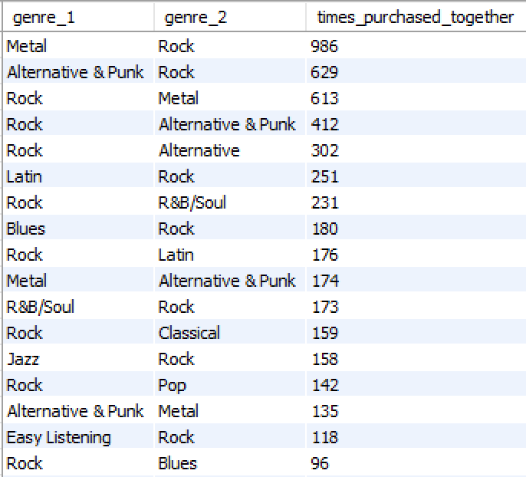
Affinity analysis
Speaking of a genre that was bought together with another genre, Rock was bought with other genres most number of times. So cross-selling initiatives should be taken for people who buy Rock as one of the genre.
Based on frequently purchased genre pairs, create bundle offers that include both Rock and its frequent pairings, such as:
Rock & Metal, Rock & Alternative & Punk, Rock & R&B/Soul etc.

Slide 13
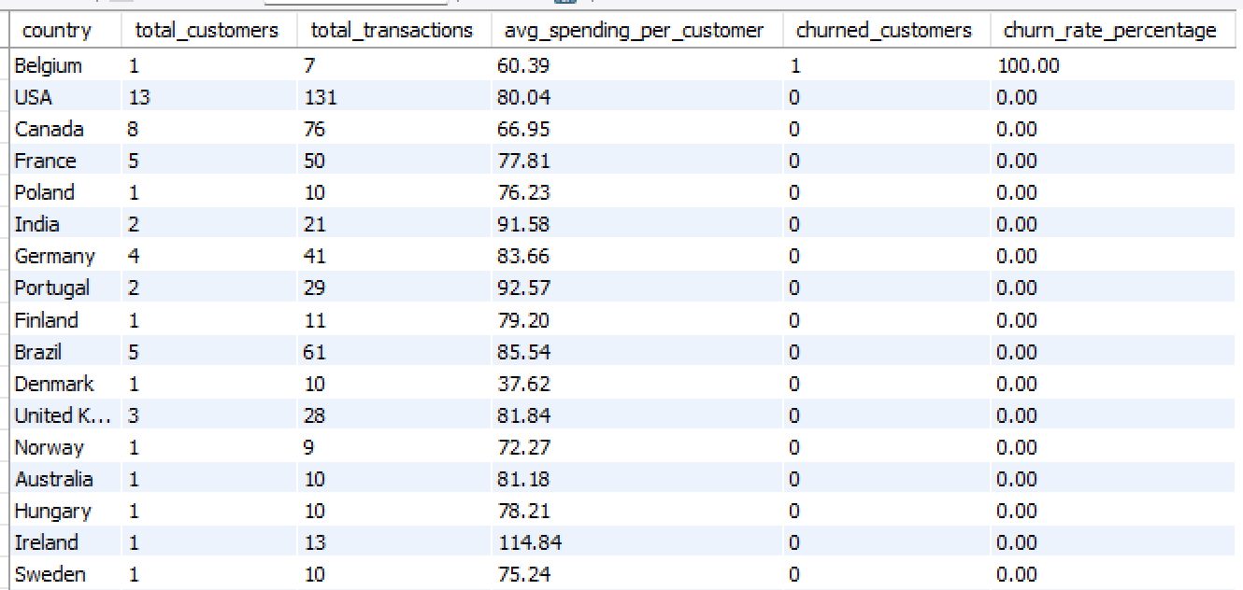
Churn rates by region
Very small customer base (only 1 customer) in Belgium, meaning a single churn skews the data.
USA & Canada: Largest Customer Bases, No Churn
Countries like India, Brazil, Portugal have a higher average spending per customer but still maintain zero churn

Slide 14
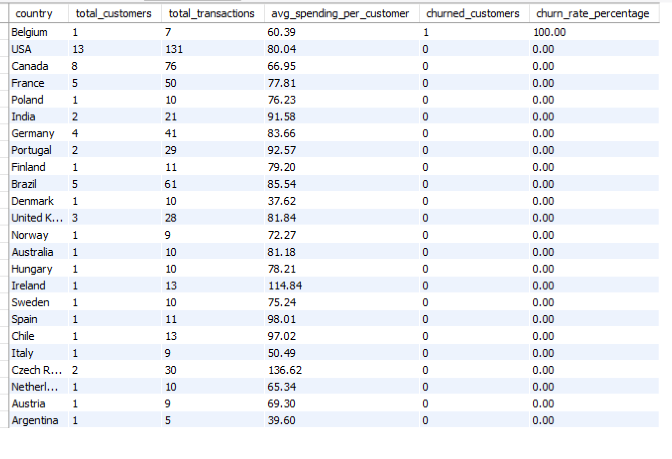
Region wise purchase behavior
USA has the highest total transactions and total customers.
Countries like India, Brazil, Portugal have a higher average spending per customer
There should be advertisements and special deals for countries with only 1 or 2 customers to promote more engagement.

Slide 15
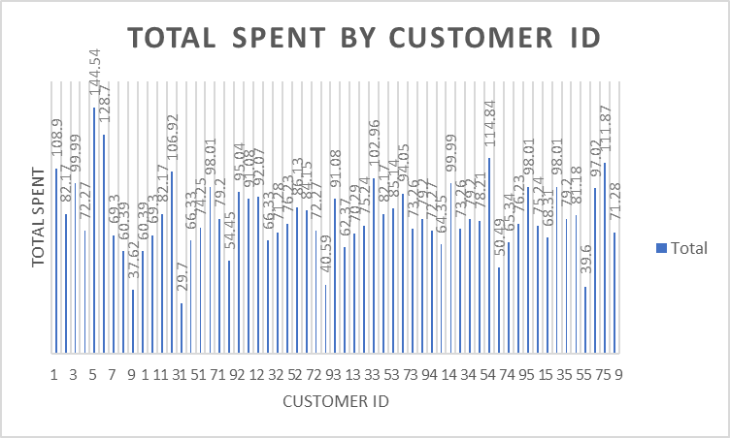
Customer segments based on purchase history
Customers were segmentized based on frequency (average days between purchases), total spent and total purchases (high value, low value and moderate value), and churn
status (active, churned, at risk).
Most customers who are churned belong to the moderate value segment.
Customers belonging to the high value segment are usually active.
Most customers belong to the high frequency segment.
None of the customers belonging to the low frequency or moderate frequency segments are churned. This can be because buying after a lot of days made their latest order date in the past 6 months.

Slide 16
recommendations
Exclusive deals and advertisements in countries with less total customers.
Cross-selling initiatives, especially in popular genres like rock where people buy multiple tracks. Discounts on full albums.
Win back discounts and incentives for churned customers, retention campaigns (like points system, exciting deals) for at risk customers, and loyalty programs for active customers (like personal offers).
Survey feedbacks for countries with high churn rates.
Advertisement of tracks/albums which have lesser reach (distinct customers) but high total sales.

Slide 17
conclusion
Major work needs to be done on the countries with 1 or 2 customers to increase engagement.
Countries like Czech Republic should be given priority because of less customers but high potential.
Focus on Rock should be kept the highest, be it cross-selling or advertising.
By leveraging these insights, the company can optimize marketing efforts, improve customer retention, and increase profitability. Implementing the recommendations will drive data-driven decision-making for long-term success

